Slide 1
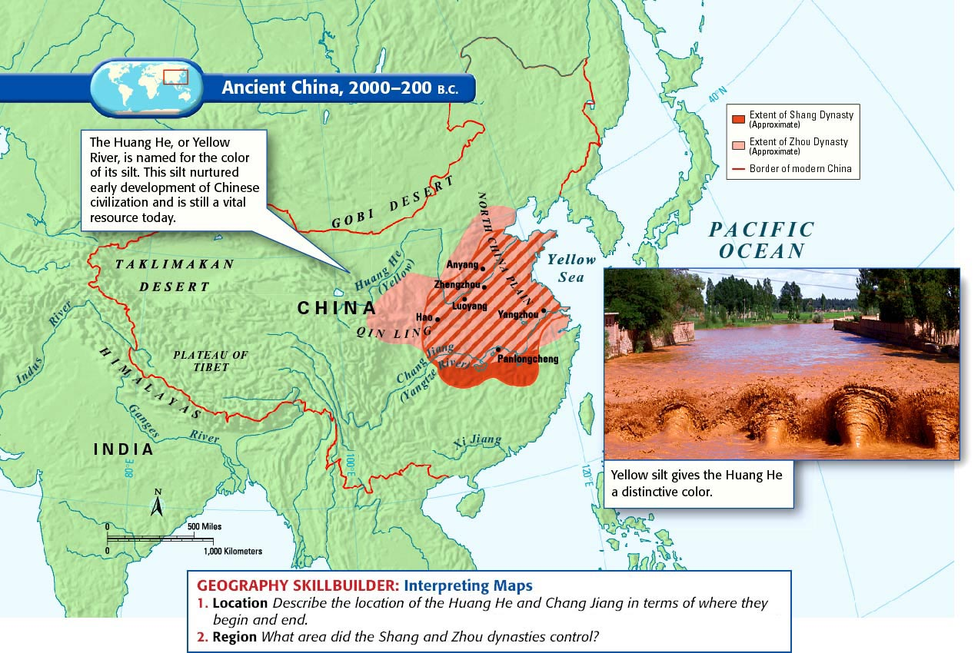
Focus: How did Chinese civilization experience major periods of stability and instability?
Do Now:
SHANG China Thought Bubble Activity
Announcements:
Art of War reading due tomorrow. See Google Classroom for details.

Slide 2
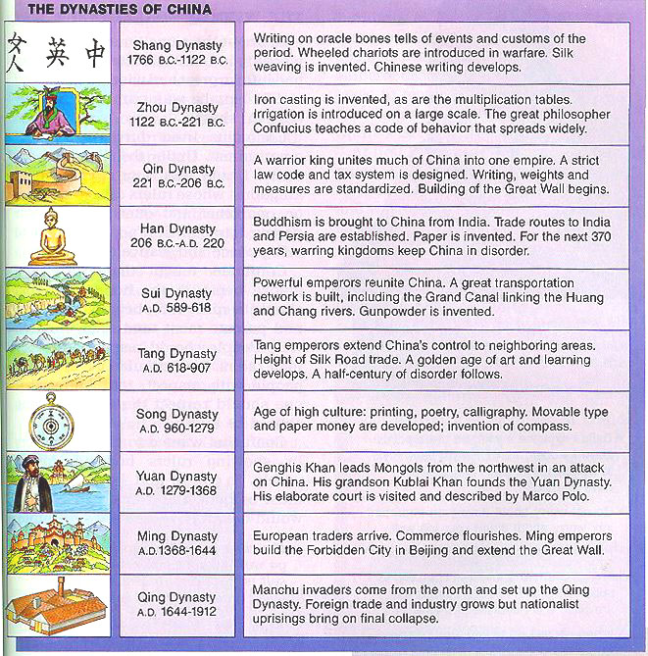

Focus: How did Chinese civilization experience major periods of stability and instability?
Looking ahead: Don’t take notes
Oldest
Ancient Chinese Civilization
←--2600 B.C.E.--600 B.C.E.---→
Classical Civilization
More
Recent

Slide 3
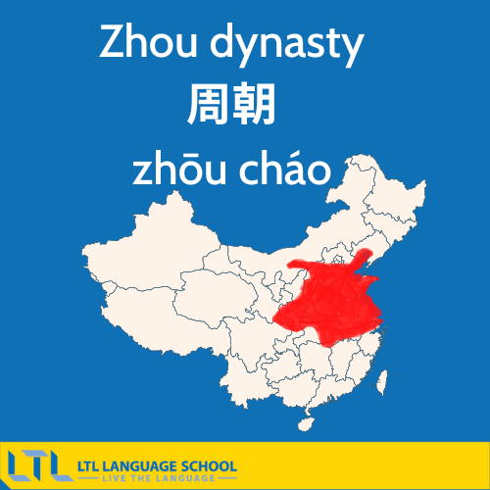
Zhou (Jo) Dynasty (1045 BCE - 221 BCE)
Aim: How did Chinese civilization reflect major periods of stability and instability?

Slide 4
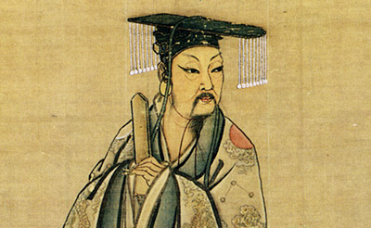
Legend of Emperor Yu- Xia Dynasty
Aim: How did Chinese civilization reflect major periods of stability and instability?
A man named Yu is revered as a devoted man dedicated to helping his country regardless of the sacrifices. Yu, was a hardworking official who labored for 13 years to drain the waters, not going home once to see his family. As a reward for his selfless efforts, the king appointed Yu the next ruler of China.
The king then said…
“Come, Yu. The inundating floodwaters filled me with dread, but then you realized all that you represented, and accomplished your task- thus showing your superiority to other men…I see how great is your virtue, how admirable your vast achievements.”
-Books of Yu
According to this legend.. What Personal Characteristics are revered by Chinese Society?

Slide 5
Zhou Dynasty 1046- 475BCE
Focus: How did Chinese civilization reflect major periods of stability and instability?
Student notes:
To justify their rebellion against the Shang, the Zhou promoted the idea of the Mandate of Heaven, or the Divine Right to Rule- They claimed that the Shang were so cruel that they angered the gods.
This same dynastic cycle has lasted through the 20th century (1912 CE). CONTINUITY!!!
Decentralized political administration through feudalism.
During the Zhou dynasty, three important Chinese philosophies developed; Confucianism, Legalism and Daoism (will be discussed further in upcoming lesson)

Slide 6
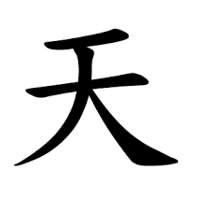
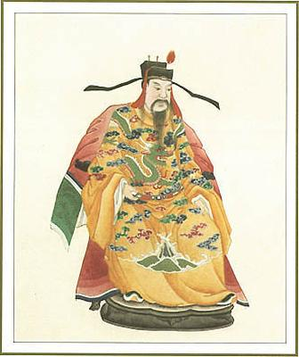
Mandate of Heaven
The Mandate of Heaven was the Chinese belief that Tian, the combined power of the cosmos, picked the emperor to rule, but could also remove a bad emperor from power.
The ruler kept the Mandate of Heaven for as long as he ruled with great virtue and morality.
Zhou rulers claimed the
Mandate of
Heaven from the Shang, who they argued were barbaric flesh eaters!

Slide 7
How does the idea of the “Mandate of Heaven” explain the dynastic cycle?
Start here→
A new dynasty comes to power.
The emperor reforms the govt. & makes it more efficient.
Emperor is defeated !!
Lives of common people improved; taxes reduced; farming encouraged.
The Dynastic Cycle
Rebel bands find strong leader who unites them. Attack the emperor.
Problems begin (extensive wars, invasions, etc.)
Poor lose respect for govt. They join rebels & attack landlords.
Taxes increase; men forced to work for army. Farming neglected.
Droughts, floods, famines occur.
Govt. increases spending; corruption.

Slide 8
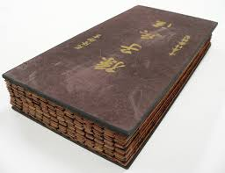
HW ASSIGNMENT
The Art of War by Sun Tzu
Even though Sun Tzu’s book on military tactics was written in the 5th century BCE, it is considered a classic in military circles and is still used and studied today. It consists of thirteen chapters, each devoted to understanding a different aspect of war.
Each of you has received a number. The number you received correlates with your assignment for tonight's HW/tomorrow’s activity.
1: Discussion Director (see directions on Warring States Period HW)
2: Connector/Researcher (see directions on Warring States Period HW)
3: Literary Luminary (see directions on Warring States Period HW)
4: Scribe (see directions on Warring States Period HW)

